Slide 1


RIO: A Pervasive RFID-based Touch Gesture Interface
Swadhin Pradhan¹, Eugene Chai², Karthik Sundaresan², Lili Qiu¹, Amir Khojastepour², Sampath Rangarajan²
1
2
MobiCom 2017
Notes:
Thanks Fadel for the introduction. Good afternoon everyone ! I am Swadhin and I will be presenting our paper titled ‘Rio: A Pervasive RFID based touch gesture interface” . This is a joint work with my advisor Lili and Eugene, Karthik, Amir and Sampath from NEC Labs America.

Slide 2
LOTS of Connected Devices by 2020
~30 Billion*
*Ericsson Research
Notes:
Internet of things are becoming more and more common place. They surround us and are changing the meaning of physical places. It has been predicted that there will be around 30 billion connected devices by 2020, Ericsson.
Ref: http://spectrum.ieee.org/tech-talk/telecom/internet/popular-internet-of-things-forecast-of-50-billion-devices-by-2020-is-outdated

Slide 3


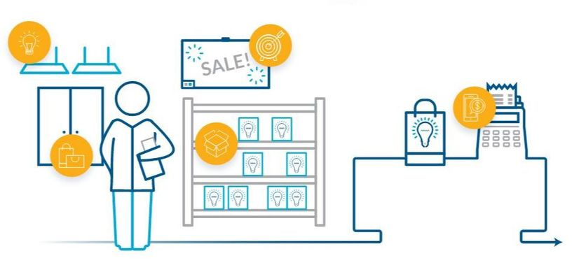
Smart Spaces
Smart Hospitals
Smart Offices
Smart Retail
Notes:
With this unprecedented proliferation of IoT, every known physical surrounding is transforming into smart and interactive spaces. This transformation is slowly becoming a reality, not only in just home through connected appliances, but in every other imaginable physical spaces: from hospitals to offices to retail.

Slide 4



Can we effectively transform everyday object into a touch Interface ?
Notes:
However, the future of IoT demands seamless and intuitive interface between users and the devices. In this setting, we ask that “Can we effectively transform everyday object into a touch interface ?” Can every possible item in our surrounding become a gateway to a possible interaction ?

Slide 5
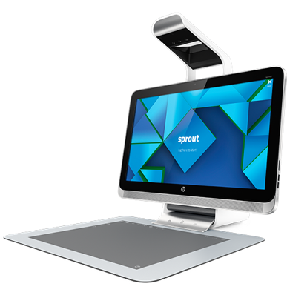
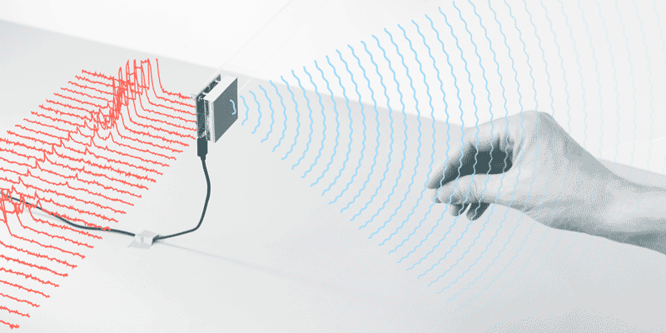
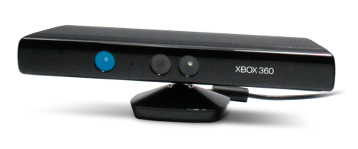
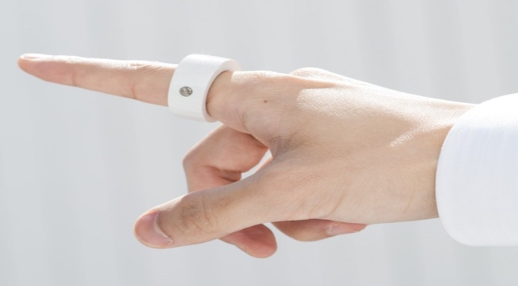
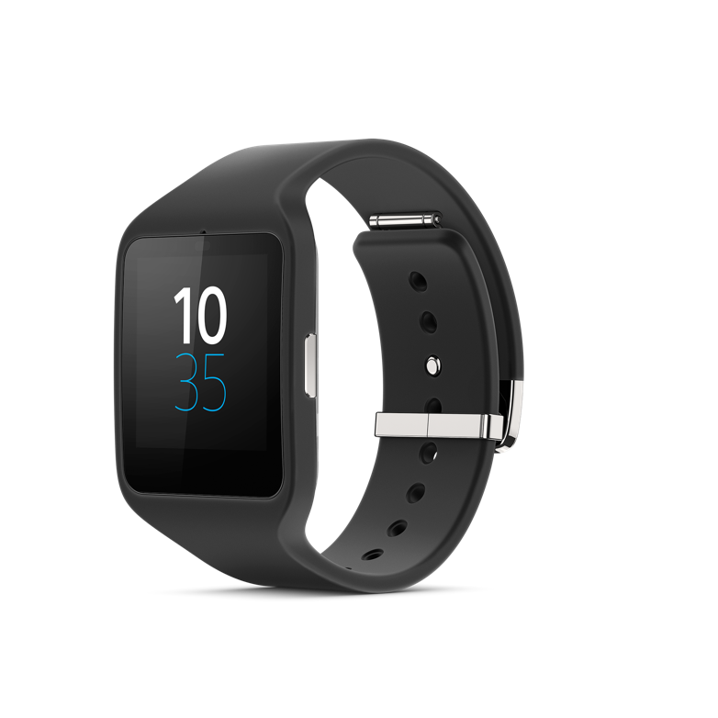
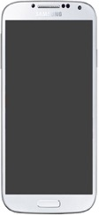
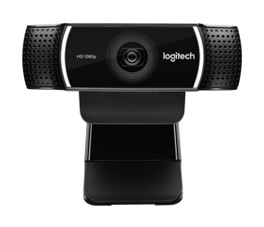

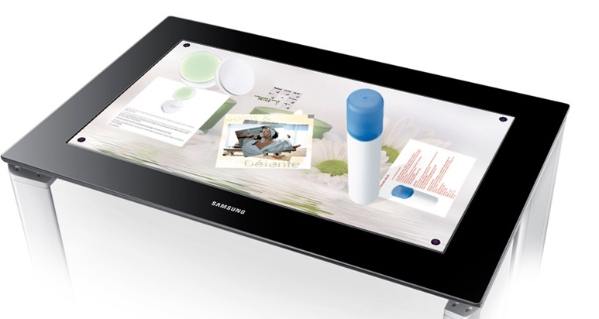
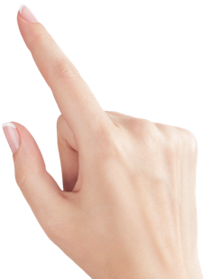
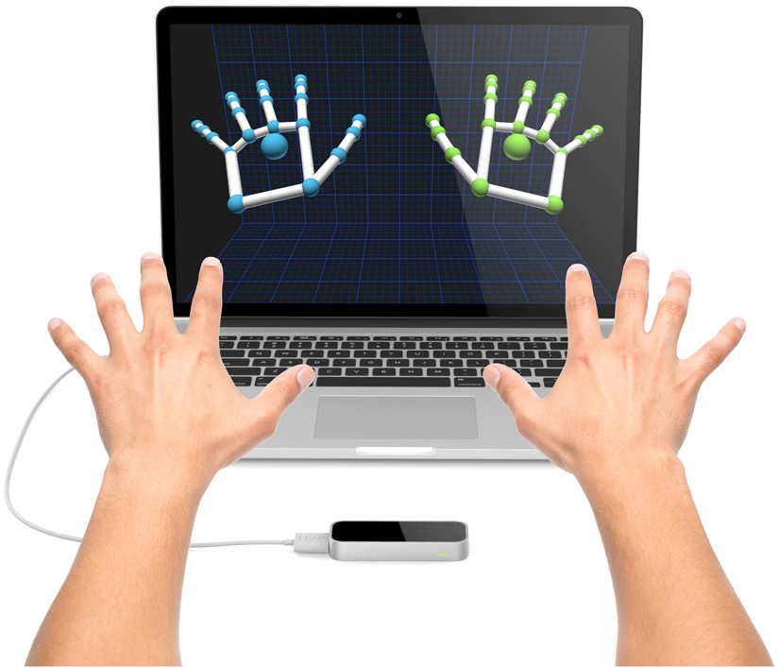
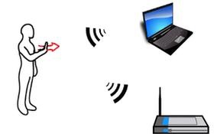
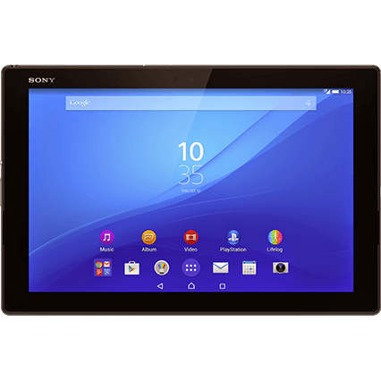
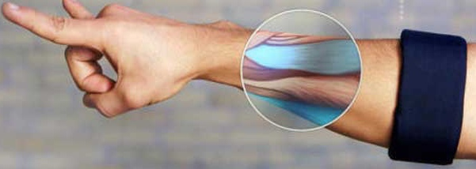
Wireless
Capacitive
Vision
IMU
Notes:
Now, let’s see what others modalities are present. To realize that goal, different types of modalities have been shown through products or research prototypes. Capacitive touch screens are present in every smartphone or tablet. Kinect and leap motion are using rgb & ir camera vision based technology to track hand movement. Wearables like smart watch is using IMUs to track different hand movement. Furthermore, 60 GHz, Wi-Fi and acoustics signals are used to track hand gestures.
Pixelsense, kinect, soli, sprout, myo, leap motion

Slide 6
Issues with these modalities
Not easy to customize
Not low cost
Extensive training phase
Need to be recharged frequently …
Notes:
However, these interaction modalities enable a suite of applications, there are few issues impacting the wide-spread adoption in smart spaces. Vision is to make everyday object touch-aware and so it will be difficult to achieve that. These UIs are difficult to customize for specific use cases and some of them require extensive training phase to be used. These UIs can also not be disposed after the use which may be needed in medical use cases and it needs to be recharged very frequently.
Low cost point massive deployment..
But, there are certain issues Coupled with device (sprout), Occlusion (vision), complex processing (soli) etc.

Slide 7

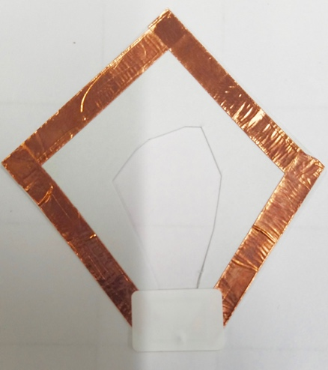
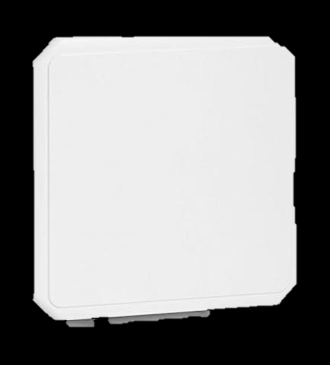

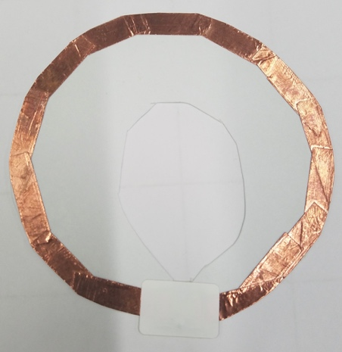

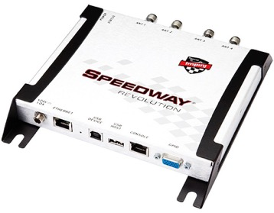

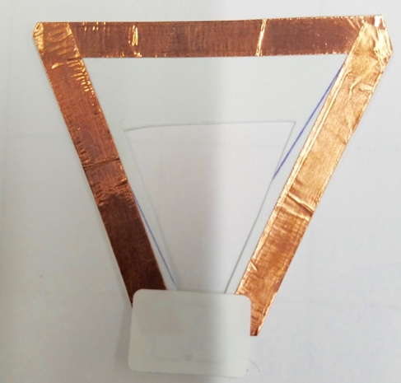
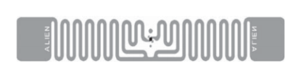
Passive RFID tags as touch interface
COTS Tags
Custom Tags
COTS Reader/Antenna
Notes:
But how ? To realize this goal of transforming physical object into UI, we re-purpose the use of commercial off-the-shelf passive RFID tags as a touch primitive. We attach the RFID tags into objects as interaction units. We use commercially available reader and antennas to aid that use case. We also build our custom-designed tags to show different other use cases.

Slide 8
And that interface …
Customizable and less costly
Battery-free
Supports fine-grained tracking
Multi interface support
Notes:
Thus, due to the use of passive RFID tags, the interface becomes battery-free and disposable. We have also shown possible customization through custom designed tags and we have built algorithms to support fine-grained tracking. Furthermore, as the tags can be easily mapped to different objects, same interaction can also be coupled with different applications. We can discriminate and support separate interfaces within the same region.

Slide 9

Keyboard
Slider
Button
Multiple Sliders
Shapes
Dial
Notes:
More specifically, we are looking at different types of single point touch and tracking. For example, different possible UI units can be Button .. Keyboard .. Slider .. Dial .. Multiple sliders .. And different shapes .. To achieve this we need to perform touch detection, tracking, and tracking within multiple tags ..

Slide 10
Key Idea and Reasoning
Touch and Single Tag Tracking
Tracking within Multiple Tags
Evaluation
Notes:
Now, let me delve into the detail of RIO. I will talk through the system following this outline.

Slide 11
Key Idea and Reasoning
Touch and Single Tag Tracking
Tracking within Multiple Tags
Evaluation
Notes:
First, let me start with the key idea behind RIO.

Slide 12
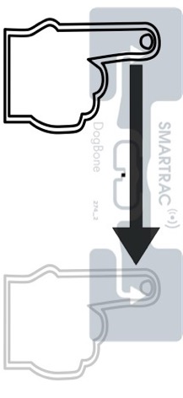

Predictable phase change
at reader side
Antenna
Tag
Finger Swipe
on Tag
Reader
Notes:
A RFID system works by sending RF signal and records the backscatter signal to know the amplitude and phase. When user touches or swipes over a passive RFID tag there is a predictable phase change is observed at the reader side.

Slide 13
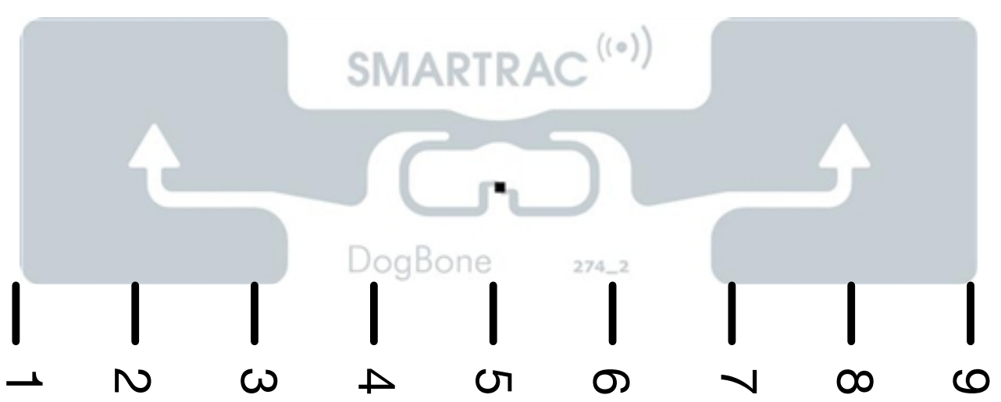

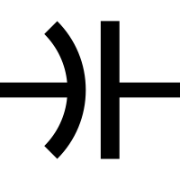

Why does it happen ?
^{Z}_{Antenna}
Backscattered Electric field
and Phase
^{Z}_{Chip}
Induced Current ∝$\frac{Incident Electric Field}{Zchip+ZAntenna}$
^{Z}_{Body}
Notes:
Now, let us look at why this thing happens. Every passive RFID tag consists of a chip and antenna. Here, the numbers present the The impedances are presented as .. Human body impedance can also be constructed as Zbody. Induced current in passive rfid tag can be shown as :

Slide 14
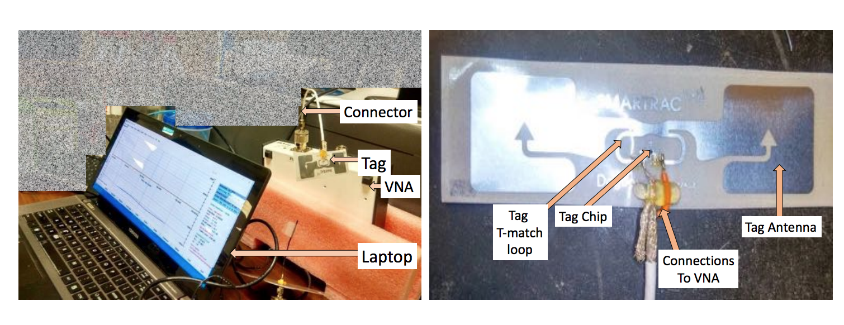
VNA based measurements
Notes:
To confirm this observation and model, we also perform vector network analyzer based experiments where we connect the tag with the VNA

Slide 15
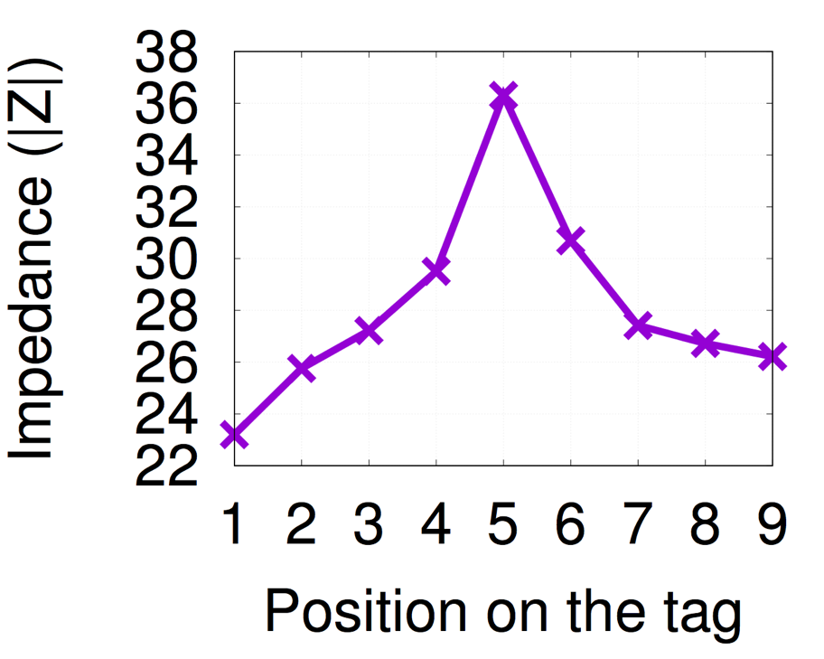
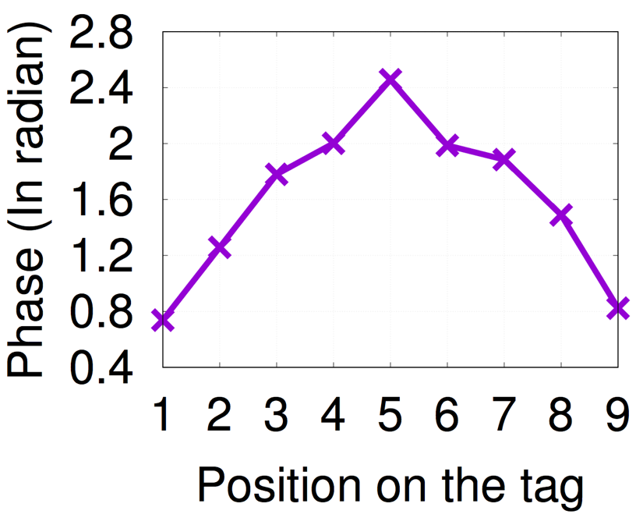
VNA based measurements
Notes:
We touch at different positions at the RFID tag and measure the impedance and the induced phases. We observe the changes.

Slide 16
Key Idea and Reasoning
Touch and Single Tag Tracking
Tracking within Multiple Tags
Evaluation
Notes:
Let’s talk about single tag touch tracking which may enable button, slider, dials and different shape drawing.

Slide 17
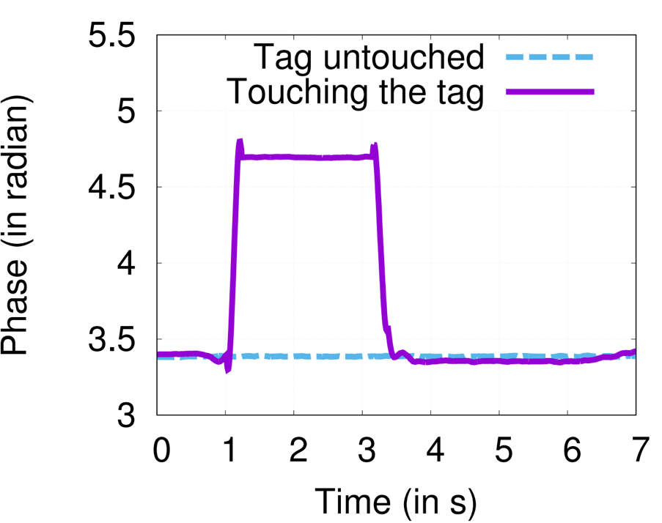
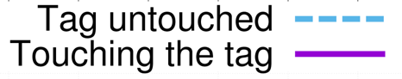
How to detect touch ?
Sudden Jump in Phase
Notes:
We observe sudden jump in phase when we touch.

Slide 18
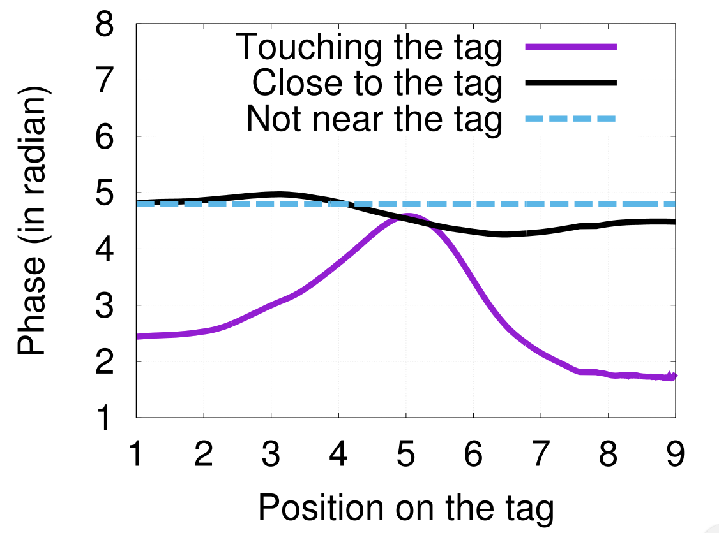
How to detect tracking ?
Predictable Phase Pattern
Notes:
We observe predictable phase pattern which we can exploit to track.

Slide 19
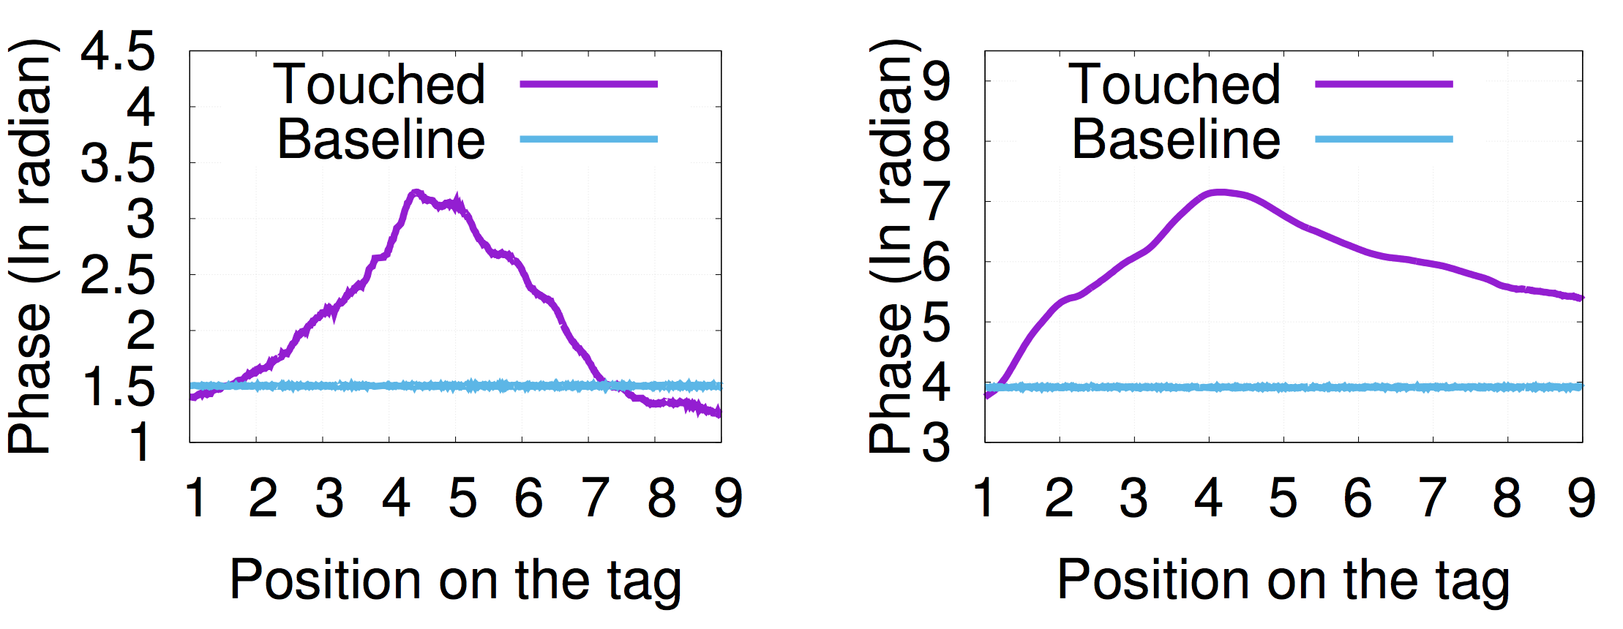
This change is also present in NLoS
Remains Similar
Behind a Wall
Behind a Door
Notes:
Interestingly, the phase pattern dominant in NLoS specific scenarios.

Slide 20
Single tag tracking algorithm sketch
T-second
Swipe Phase
Phase
DTW Matching
Calibration Phase
Potential
New Position
Last Known
Position
Tag Position
Notes:
Now, let’s look at the algorithm sketch. Upper right hand corner shows a demo run if the algorithm. Initially we swipe our finger 3-4 times the calibration phase pattern. .. And then we repeat this process.

Slide 21
Key Idea and Reasoning
Touch and Single Tag Tracking
Tracking within Multiple Tags
Evaluation

Slide 22
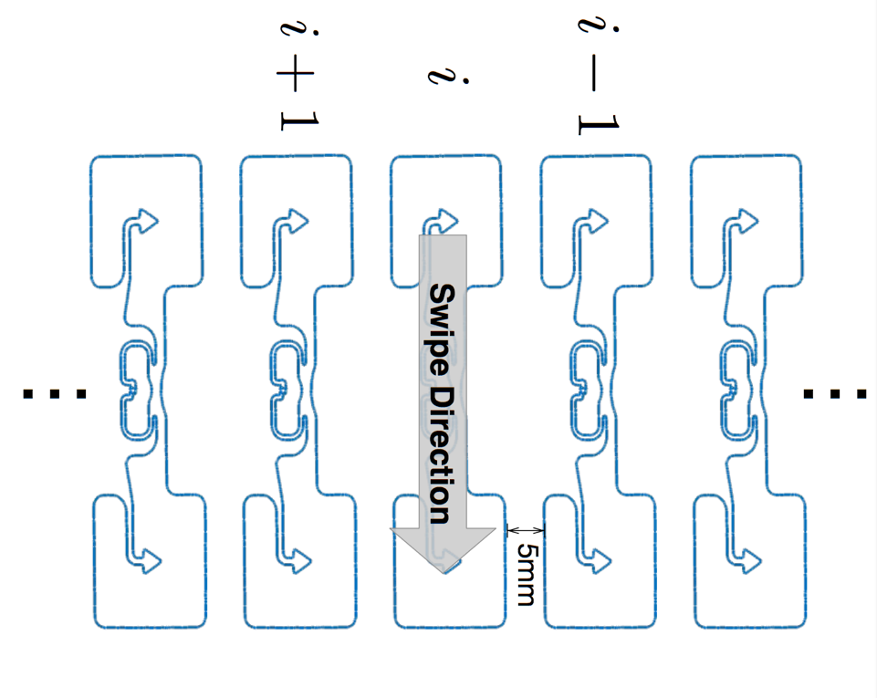
Tracking within Multiple Tags
Notes:
Then we attempt to extend We also look at tracking of tag within multiple tags. The tracking becomes worse because of the mutual coupling between tags change the observed phase pattern. However, all of the previous works actually negated the impact of mutual coupling.

Slide 23
Mutual coupling phenomenon
Neighboring tags show
reverse phase pattern
Notes:
However, there will be mutual coupling and we observe the reverse phenomenon.

Slide 24
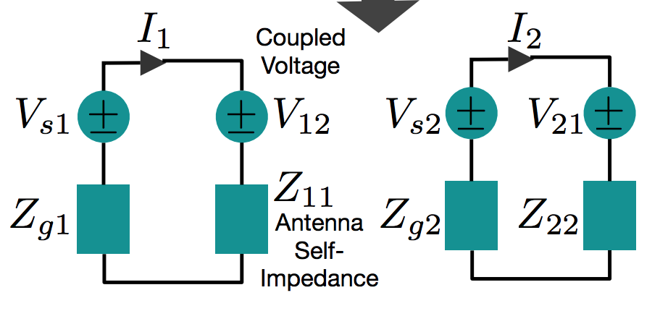
Why does it happen ?
Coupled mutual impedance has
reverse impact in back-scattered phase
Notes:
The details about the model are in the paper but the basic idea is that coupled mutual impedance has reverse impact in the backscattered phase.

Slide 25
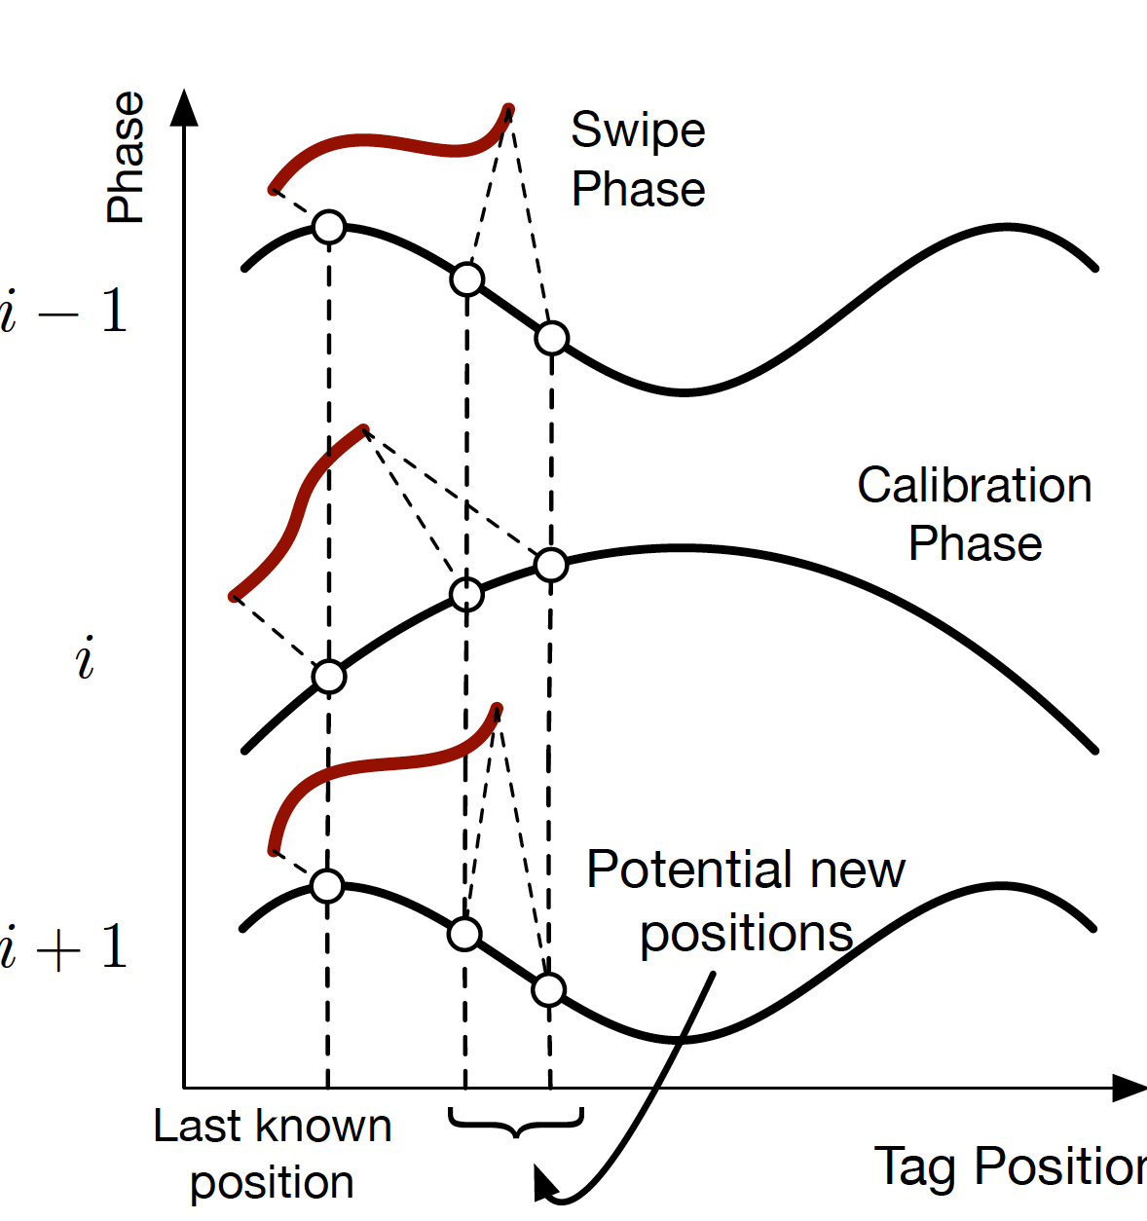
Multi tag tracking algorithm sketch
Apply joint
DTW matching
Notes:
We use that phase changes across neighboring tags to improve the tracking in multi-tag scenario.

Slide 26
Key Idea and Reasoning
Touch and Single Tag Tracking
Tracking within Multiple Tags
Evaluation

Slide 27
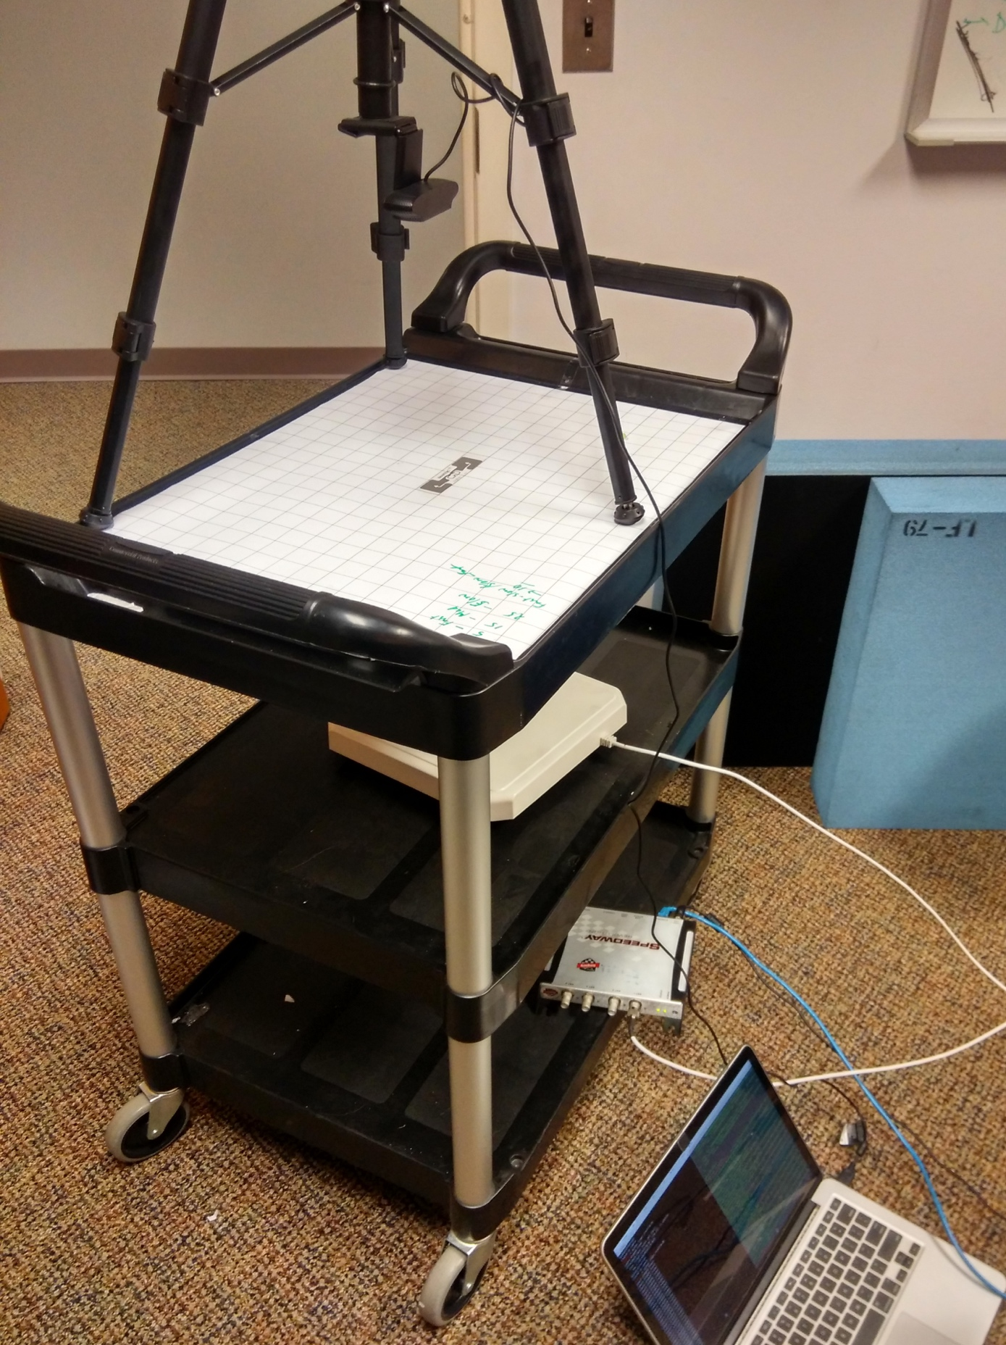
Experimental Setup
Camera
RFID Tag
Antenna
Reader
Laptop (Processing)
Notes:
We have a camera with opencv to measure the ground-truth.

Slide 28
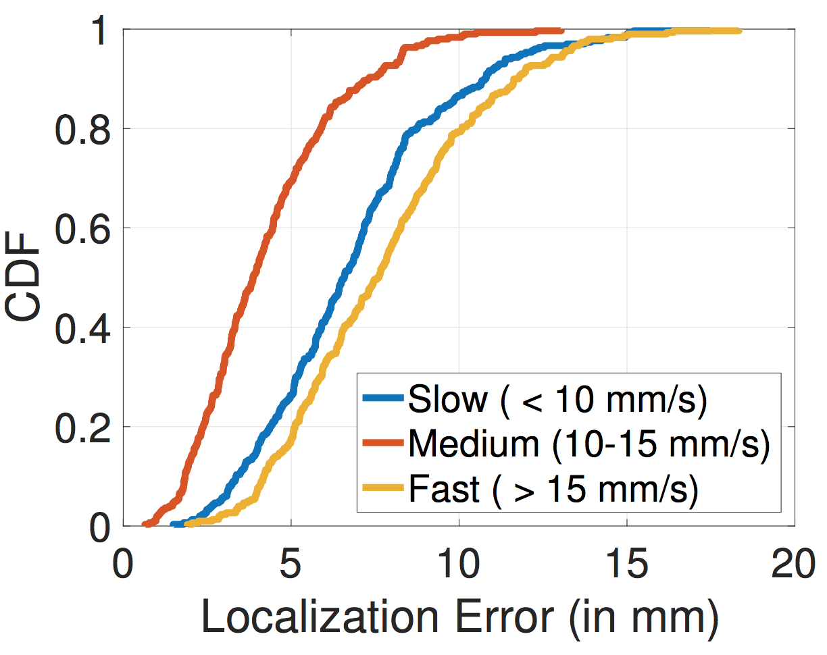
Single Tag Tracking Accuracy
Error ~10 mm
Notes:
We test the localization tracking error in different speeds of finger movements. And we observe that. Mention Speed.

Slide 29
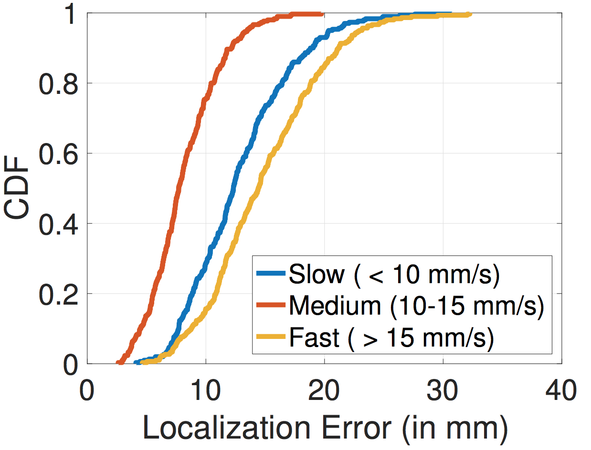
Multi Tag Tracking Accuracy
Error ~18 mm
Notes:
If we look at the tag tracking in multiple tags..

Slide 30
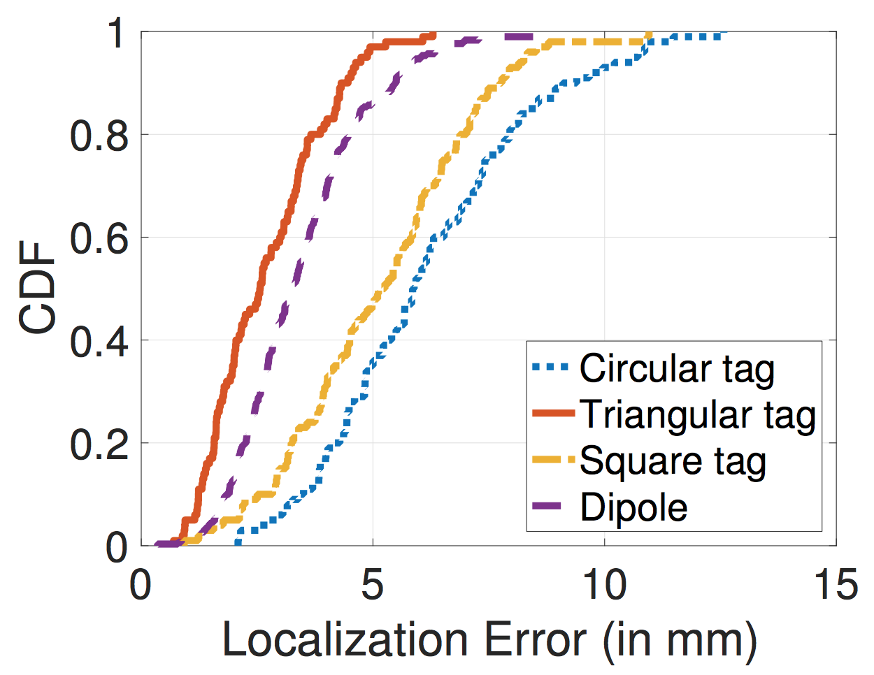
Custom Tag Tracking Accuracy
Error ~10 mm
Custom Tags
Notes:
We also build custom tags with loop tags and copper tapes and apply our single tag tracking algorithm. For more detailed evaluation results, please look into the paper.

Slide 31
Related Works
RFID based gesture recognition – Data-driven learning
ShopMiner (SenSys ‘15), FEMO (SenSys ‘15), CBID (ToN ‘16) …
RFID tag tracking – Tracks tag movement
RF-IDraw (SIGCOMM ‘14), Tagyro (Mobicom ‘16), PolarDraw (CoNext ‘16) …
RFID based UI (Closest) – ML on a fixed set of gestures
PaperID (CHI 2015), IDSense (CHI 2016) …
Notes:
Before concluding, I just want to point out there are numerous previous attempts to use passive RFID tags as interaction units. RIO improves upon this work with high accuracy, low over head, error rate.

Slide 32
Future works
Multi-touch tracking
General 2D gesture tracking
Tracking in different environment scenarios
Building customized tags for other use cases
Notes:
However, this is just a first step realizing the ultimate goal of transforming every physical object into a possible UI. Multi –touch.. 2D gesture

Slide 33
Key takeaways
Impedance Tracking based Touch Primitive
Mutual coupling can be exploited
Custom designed tags may enable different applications

Slide 34
Thanks! Questions ?
swadhin@cs.utexas.edu

Slide 35
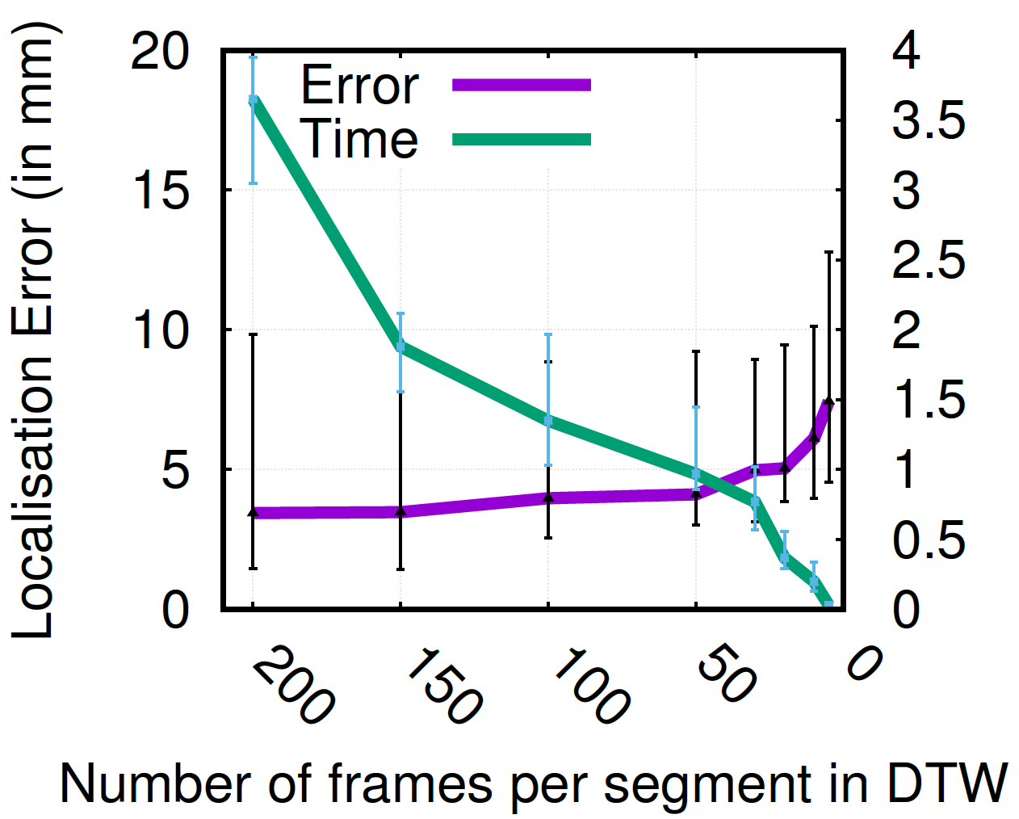
Localization Error Trade-off

Slide 36
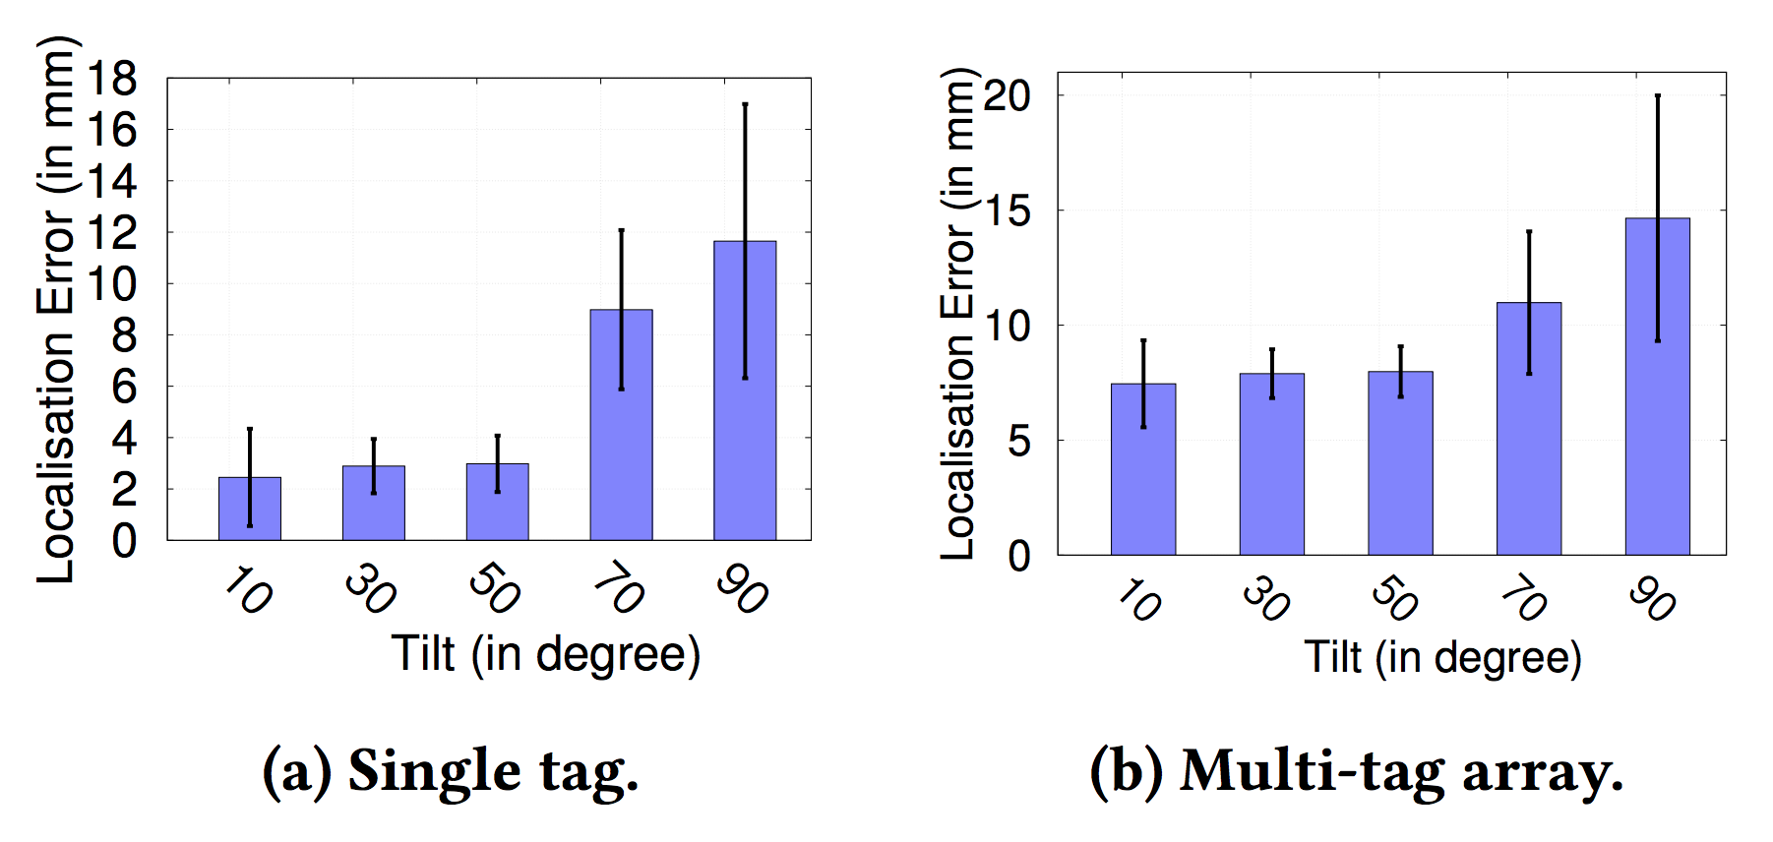
Relative Tilt Angle change of Antenna
Error remains within ~20mm

Slide 37
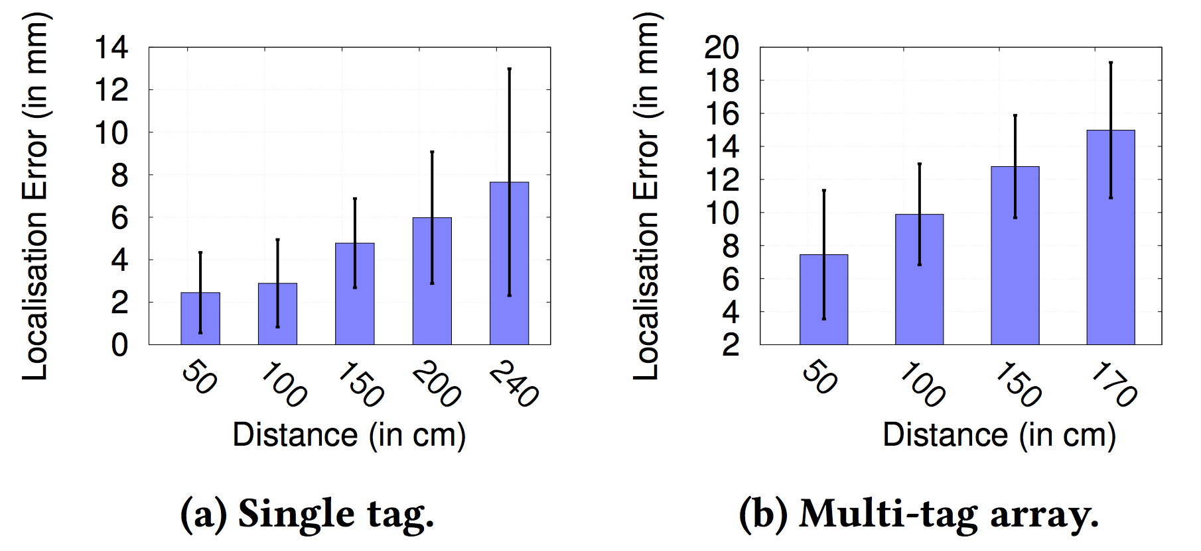
Distance change from Antenna
Error remains within ~18mm

Slide 38





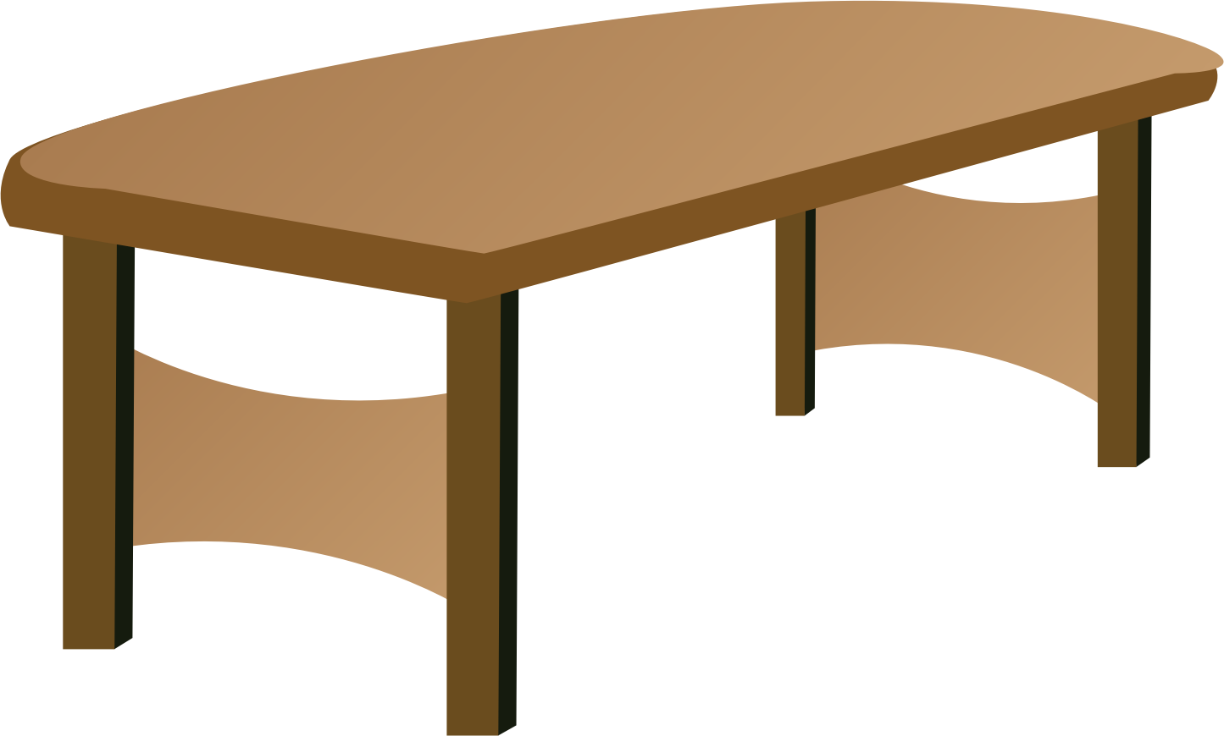

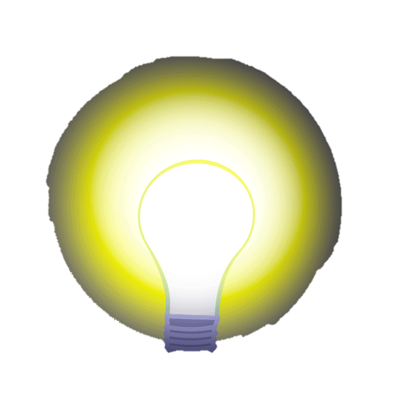
Antenna
Reader
Inside an RIO-enabled Interactive Home
Notes:
Now let’s see a glimpse of RIO in action in a smart space. And by doing this, we can make everyday smart-space more interactive .. For example, in this example scenario, Alice is in a smart-home touches a RIO touch button and the canvas lights up .. Then she goes on to play her keyboard in the table which is RIO-enabled. Finally, she goes on to touch over a dial to increase the brightness of a light.

